Slide 1

Customer Experience & Service Performanc
Measuring satisfaction, identifying challenges, and highlighting improvement opportunities
Khafy Company

Slide 2
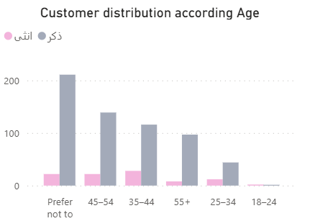
Who Are Our Customers?
Current scenario:
  “Majority of users are Male and aged 35–54, primarily male. Indicates strong adoption among property owners in mid-age groups.”
  Also big category don’t prefer to tell about their age

Slide 3
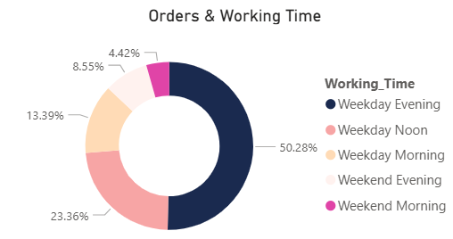
How Our Services Are Performing
🎯 Key KPIs
  Total Customers: 702
  Total Cities Served: 41
  Average Service Delay: 14.04 Minutes
  Peak Working Time: Weekday Evenings (50.3%)

Slide 4
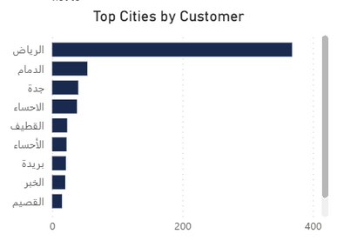
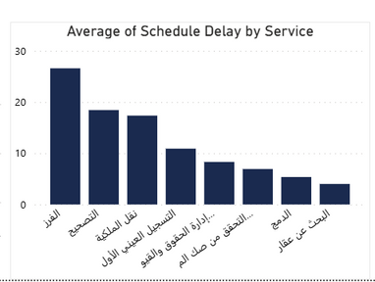
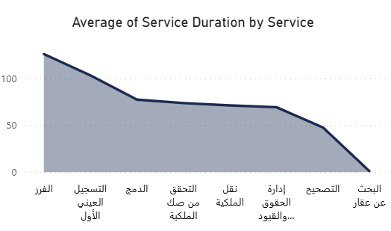
💡 Key Insights
High Service Engagement
Geographical Concentration
  Riyadh dominates customer activity, followed by Dammam and Jeddah — confirming that urban centers remain the primary adoption hubs.
  “Registration and Ownership Transfer services represent the highest demand, accounting for over half of total requests.”
Service Duration Efficiency
  Average completion time varies notably; “sorting” and “first physical registration” services show longer durations, signaling a need for process optimization.

Slide 5
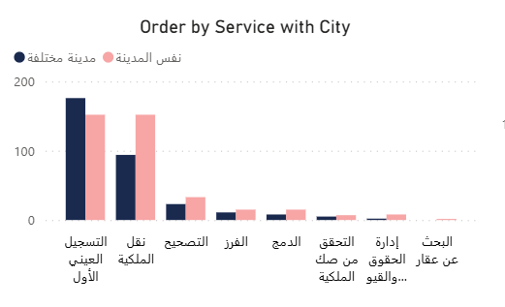
Order Distribution by Service and City Relation
  Service requests are primarily local and concentrated in core operations such as registration and transfer.
  This indicates customer familiarity with digital property management in their own city, while cross-city requests remain minimal.

Slide 6
Key Takeaway
  “Most service requests occur during weekday evenings, driven mainly by property registration and ownership transfer transactions.
  While response times remain stable overall, certain high-volume services such as correction and merging show longer completion durations, indicating areas for process streamlining.”
  While service adoption is strong across cities, the first registration process tends to take longer when the property is located in a different city.
  This reflects logistical dependencies between regional offices and suggests potential efficiency gains through centralized digital verification.

Slide 7
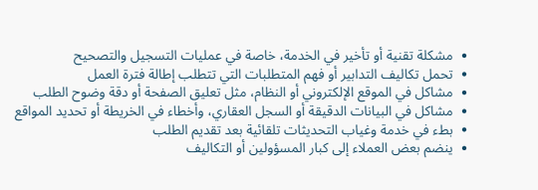

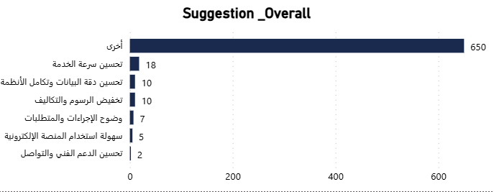
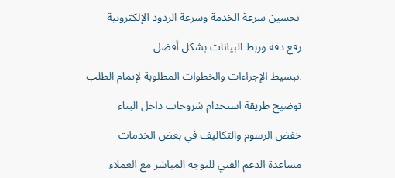
Customer Experience & Satisfaction Summary
Key Customer Challenges
Dissatisfaction & Experience:
Improvement Suggestions

Slide 8
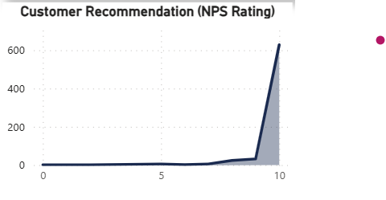
Customer Recommendation
  The service achieved an exceptionally high NPS score, indicating strong customer loyalty and satisfaction.
  Maintaining this trust will depend on continuous improvement in technical performance and communication consistency.

Slide 9
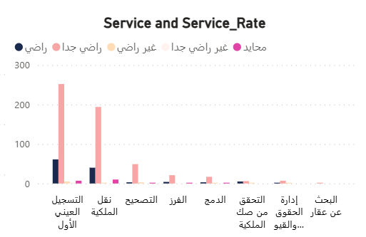
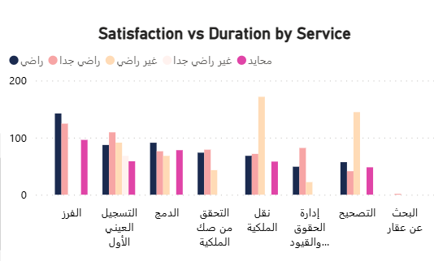
Customer Satisfaction by Service Type
Enhancing service efficiency particularly in time-intensive processes like correction and transfer will directly boost satisfaction and trust.
Shorter wait times and smoother workflows equal happier, more loyal customers.

Slide 10
Conclusion
Customer feedback reflects overall satisfaction but highlights systemic issues in technical performance, clarity of process, and response time.
Addressing these will enhance trust, streamline digital interactions, and further elevate customer experience.

Slide 11
Thank you

